Slide 1
What is a hypothesis?

Slide 2
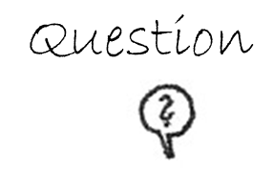
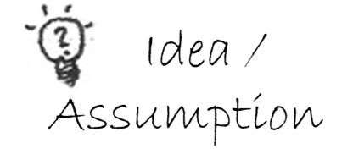
The word „hypothesis“ means assumption or idea
Images according to Prof. Dr. Brunhilde Marquardt-Mau included with kind permission from DKJS,
© Deutsche Kinder- und Jugendstiftung (DKJS), www.forschendes-lernen.net

Slide 3
Look at the following pictures.
Make hypotheses (assumptions) in relation to the question.
It is not about whether the hypothesis is confirmed, but only about your assumptions.

Slide 4
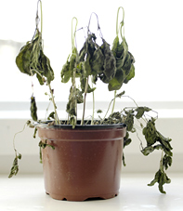
Why did this plant die?
"Dieses Foto" von Unbekannter Autor ist lizenziert gemäß CC BY-SA

Slide 5
What does this cloud cover mean for the temperature?
"This photo“ by Unknown Author is licensed under CC BY-SA

Slide 6
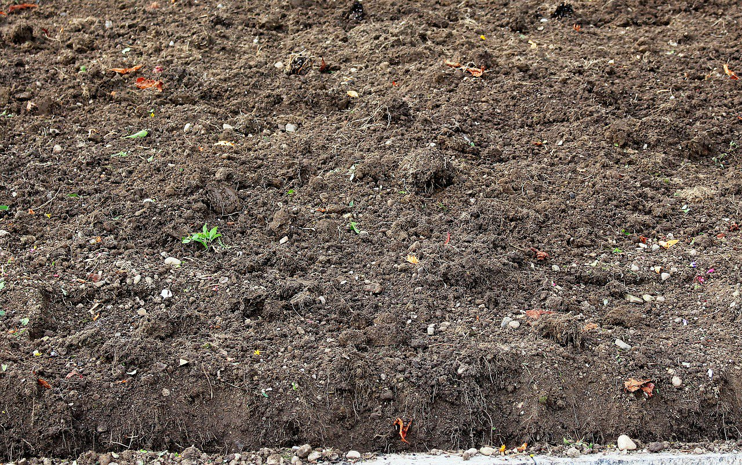
How wet is this soil?
"This photo" by Unknown Author is licensed under CC BY-SA

Slide 7
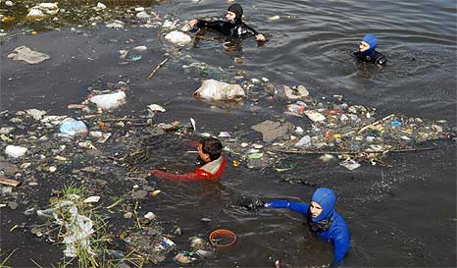
What is the water quality of this water body?
"This photo" by Unknown Author is licensed under CC BY-NC

Slide 8
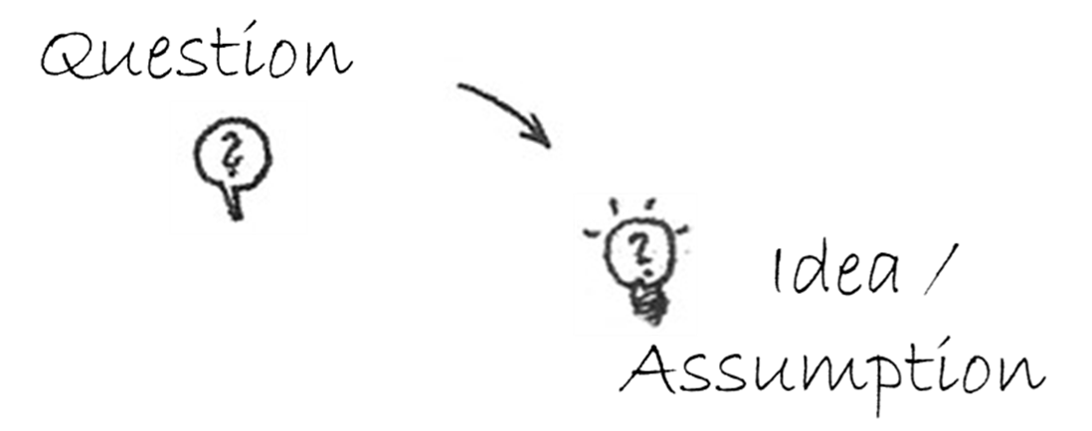
A good hypothesis…
clearly refers to the question.
can be tested by measurements or observations.
can be confirmed and refuted.
✓ ✗

